Slide 1
Programming 101 Day 4
Basic Data Structures

Slide 2
Outline
String
Errors

Slide 3
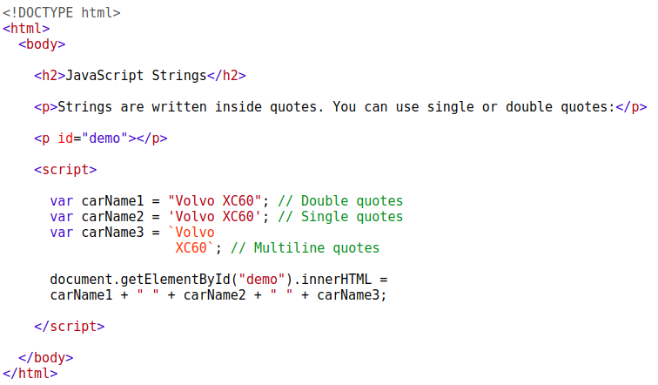
String

Slide 4

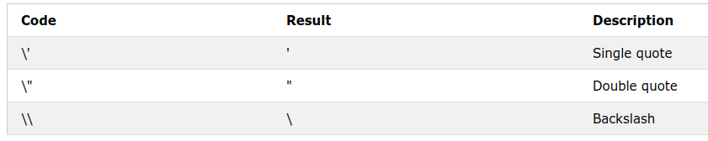
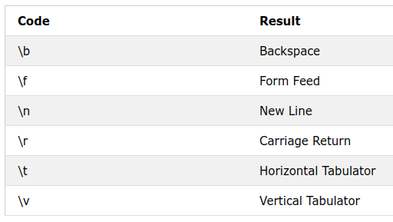
String

Slide 5


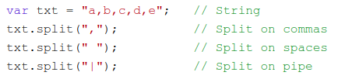
String

Slide 6
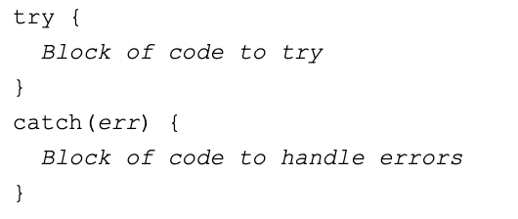
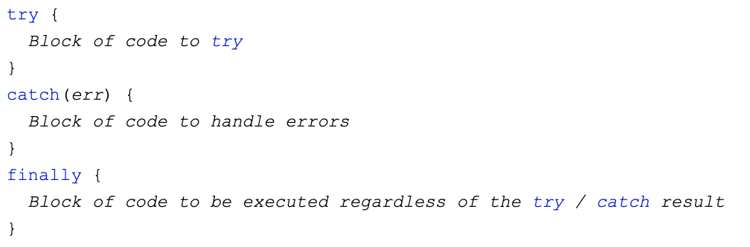
Errors

Slide 7
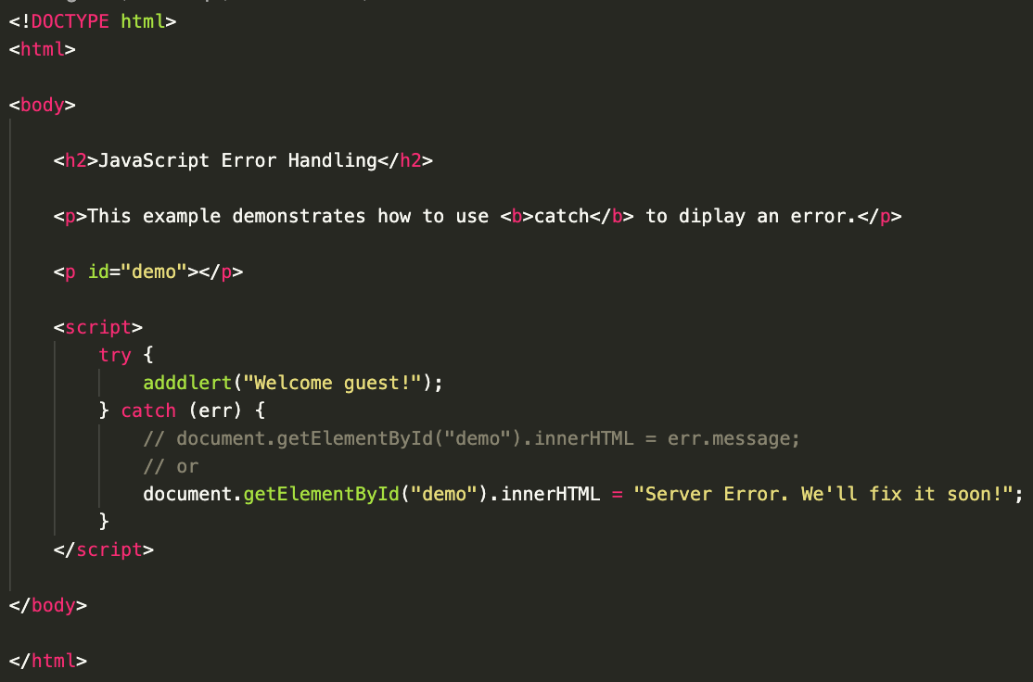
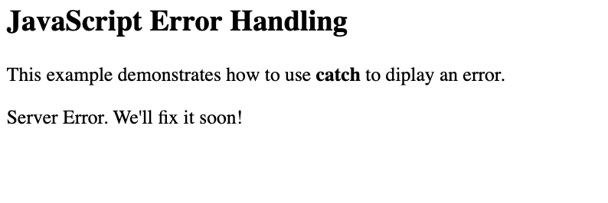
Errors

Slide 8
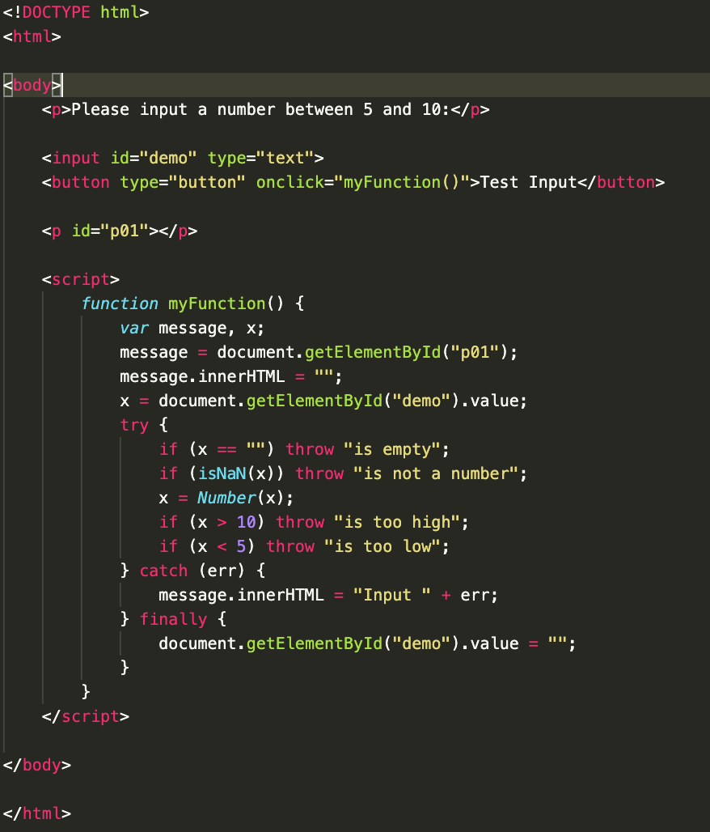
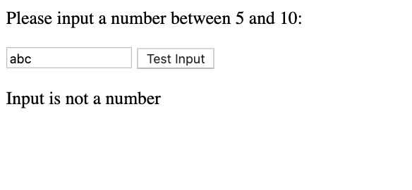
Errors

Slide 9
Keep practicing!
Write a Javascript program to show the names and ages of person in this room and count the number of the people who is between 25 – 30 years old. If they are < 25, gives an error “Too young!”, if they are > 30, gives an error “Too old!”.

Slide 10
“Nothing will work unless you do”
- Maya Angelou

